Slide 1
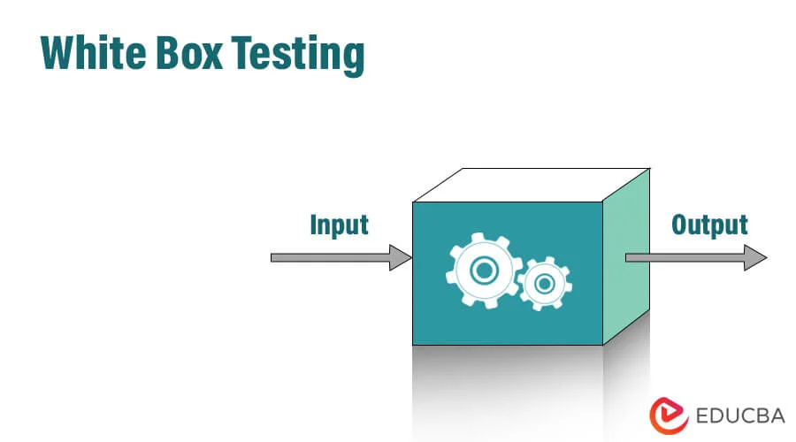
By Hasan Jawad Id:1122833

Slide 2
Definition
White-box testing is a method of software testing that tests internal structures or workings of an application, as opposed to its functionality. In white-box testing, an internal perspective of the system is used to design test cases.

Slide 3
White box testing is used for
Code verification and optimization
Finding logical errors and bugs
Unit testing
Path and branch testing
Improving code maintainability

Slide 4
Code Verification and Optimization
It ensures that the code is written efficiently and follows best practices
Helps in detecting redundant or unnecessary code

Slide 5
Finding Logical Errors and Bugs
Identifies logical errors, incorrect assumptions, and security vulnerabilities
Detects hidden bugs that might not be caught with black box testing

Slide 6
Unit Testing
Aids in testing individual components or modules of the software
Ensures each function works as intended

Slide 7
Path and Branch Testing
Tests all possible execution paths and decision branches in the code
Ensures complete code coverage

Slide 8
Security testing
Identifies security vulnerabilities such as broken authentication, SQL injections, and buffer overflows
Helps in strengthening access control mechanisms

Slide 9
White Box Testing
Advantages
disadvantages
Thorough code coverage
Early bug detection
Optimized code
Security enhancement
Time-consuming
Complex for large systems
Requires programming knowledge

Slide 10
Types of White Box Testing
Unit testing
Integration testing
Mutation testing
Regression testing
Security testing

Slide 11
Any Questions??

